Slide 1
Security and Privacy
Fall 2019
Instructor: Dr. Saeed Samet
School of Computer Science
University of Windsor

Slide 2
Chapter 3
Privacy-Preserving Methods

Slide 3


Security & Privacy?
Security
Tools and techniques to protect the Confidentiality, Integrity and Availability of information
Privacy
The right of an individual to control the collection, use, disclosure and retention of their personal information
Notes:
Security is defined based on its three goals, confidentiality, integrity and availability. Therefore, security is the set of tools and techniques to preserve confidentiality, integrity, and availability of information.
Privacy, however, is the right of an individual to control the collection, use, disclosure and retention of their personal data.
Therefore, we can say that security techniques help us to preserve data privacy.

Slide 4
Chapter Outline
Review
Data Mining
Machine Learning
Applications
Why and When privacy is needed?
Privacy-Preserving Data Mining (PPDM)
Secure Multi-Party Computation (SMC)
Homomorphic Encryption
Anonymization
Attacks on different approaches
Open issues on privacy-preserving methods

Slide 5
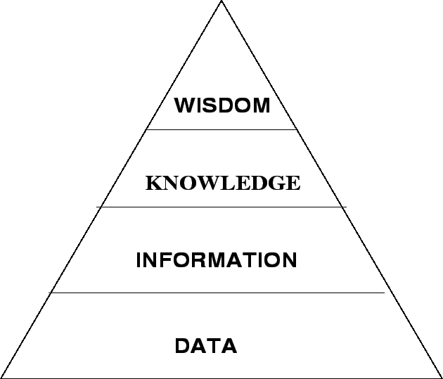
Data Mining (Brief Review)
Process of analyzing data from different perspectives and discovering useful information and knowledge, for various purposes, such as predictions and trends, financial profit (by increasing revenue and cutting costs), national or international security, …
Standard methods and algorithms to move forward in the path of DIKW (Data, Information, Knowledge, Wisdom)
Finding correlations or patterns among large amount of data
A.K.A Knowledge Discovery

Slide 6

Introduction
Data
Symbols or observations reflecting differences in the world
Example = 250.00 (Note: data is the plural of datum)
Information
Data with meaning
Example = ICD-9 code of 250.00 means type 2 diabetes
Knowledge
Information that is justifiably believed to be true
Example = obese patients are more likely to develop type 2 diabetes
Wisdom
The ability to increase effectiveness
It’s the value add based on being able to improve accuracy and drive efficiency
It adds value, which requires the mental function that we call judgment.

Slide 7
Information Hierarchy
“We are drowning in information, but starving for knowledge.” John Naisbett
DIKW Hierarchy
Data
Information
Wisdom
Knowledge
Low
O
250
Meaning
Value
Meaning
Obese
ICD-9 250
Aggregation
“Obese patients are more likely to develop T2D”
Conclusions & Decisions
High

Slide 8
Information Hierarchy
Data (Know nothing)
Symbols or observations reflecting differences in the world, that represent properties of objects, events and their environments
The lowest level of abstraction
They are of no use until they are in a useable, relevant form
Such as a number or text in a database, “8”, “F”, “080510”, …

Slide 9
Information Hierarchy
Information (Know what)
A meaningful and processed data or facts from which conclusions can be drawn by human or computer
When data is processed into an answer to an enquiry, it becomes information
Answers to questions that begin with words “who, what, when and how many”
Difference between data and information is functional, not structural
The processing of data to produce information often reduces that data, because typically only some of the data is relevant
“F” means “Female” as gender, or “080510” means “May 8, 2010” as Birthdate

Slide 10
Information Hierarchy
Knowledge (Know how)
Information that is justifiably considered to be true
As know-how allows an agent to promote information to a controlling role to transform information into instructions
A rising Prostate Specific Antigen (PSA) level suggests an increased likelihood of prostate cancer
Smokers are more likely to develop lung cancer

Slide 11
Information Hierarchy
Wisdom (Know why)
The critical use of knowledge to make intelligent decisions and to work through situations of signal versus noise
Integrated knowledge-information
Knowing the right things to do
The ability to make sound judgments and decisions without thought
The ability to increase effectiveness
A rising PSA could mean prostate infection and not cancer

Slide 12
Data Mining (Brief Review)
Categories
Association
Association Rule Mining
Classification
Decision Tree
Support Vector Machine
k-nearest neighbors (kNN)
Clustering
k-means Clustering
Hierarchical Clustering
Regression
Linear
Logistic

Slide 13
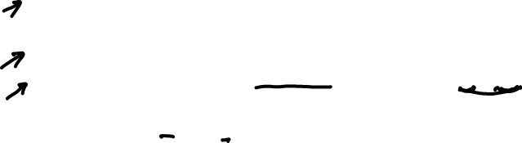
Association Rule Mining
An algorithm for discovering interesting rules or relations between variables in large datasets.
Let I={i₁ , i₂ ,…, i_{n}} be a set of n binary attributes called items.
Let T={t₁ , t₂ ,…, t_{m}} be a set of transactions.
A rule is defined as an implication of the form where and .
The itemsets X and Y are called antecedent (left-hand-side) and consequent (right-hand-side) of the rule respectively.
We are usually looking for interested rules.

Slide 14
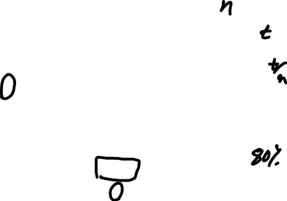
Association Rule Mining (cont.)
The support SUPP(X) of an itemset X is defined as the proportion of transactions in the dataset which contain the itemset X.
The confidence of a rule is defined as:
Association rules are usually required to satisfy a minimum support and a minimum confidence.
Association rule generation splits up into two separate steps:
Minimum support is applied to find all frequent itemsets.
The frequent itemsets and the minimum confidence constraint are used to form rules.

Slide 15
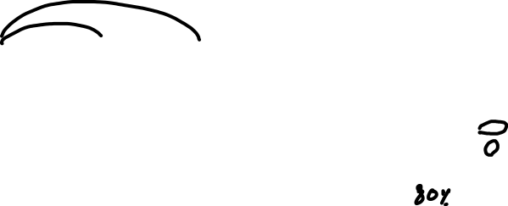
Transaction ID | Milk | Bread | Butter | Beer
1 | 1 | 1 | 0 | 0
2 | 0 | 1 | 1 | 0
3 | 0 | 0 | 0 | 1
4 | 1 | 1 | 1 | 0
5 | 0 | 1 | 0 | 0
V₁ | V₂ | V₃
1 | 1 | 0
0 | 1 | 1
0 | 0 | 0
1 | 1 | 1
0 | 1 | 0

Slide 16
Decision Tree
A tree-like structure in which
An internal node represents test on an attribute
Each branch represents outcome of test
Each leaf node represents class label
A path from root to leaf represents classification rules
A tree structure wherein
Leaves represent classifications
Branches represent conjunctions of features that lead to those classifications
ID3, Iterative Dichotomizer 3, is a decision tree induction algorithm developed by Quinlan.

Slide 17
Predictive Model
Observation
Variables
(Normal Attributes)
Conclusion
Possible Values
predicted values of target variable
(Class Attribute)

Slide 18
Decision Tree Example
Day | Outlook | Humidity | Wind | Play
1 | Sunny | High | Weak | No
2 | Sunny | High | Weak | No
3 | Cloudy | High | Strong | No
4 | Rain | Normal | Strong | No
5 | Rain | Normal | Weak | Yes
6 | Rain | High | Weak | No
7 | Cloudy | High | Weak | Yes
8 | Sunny | Normal | Strong | No
9 | Sunny | Normal | Strong | No
10 | Sunny | High | Strong | No
11 | Rain | Normal | Weak | Yes
12 | Cloudy | Normal | Weak | Yes
13 | Cloudy | High | Weak | Yes
Class (or Dependent) Attribute
Normal (or Independent) Attributes
.
.
.
.
.
.
.
.
.
.
.
.
.
.
.
18

Slide 19
Wind
Weak
Strong
Humidity
Outlook
High
Normal
Sunny
Rain
Cloudy
Outlook
Yes=7 No=0
Yes=0 No=5
Yes=0 No=4
Humidity
Sunny
Rain
Cloudy
High
Normal
Yes=2 No=3
Yes=0 No=2
Yes=2 No=0
Yes=0 No=2
Yes=1 No=0
Target Data
(Outlook= Cloudy
, Humidity = High
, Wind = Strong )
Play = No
19

Slide 20
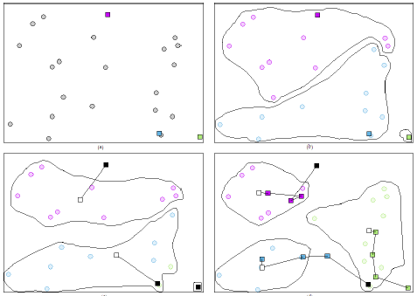
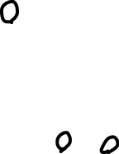
K-means Clustering

Slide 21
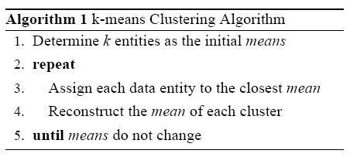
K-means Clustering
Notes:
Inside the k-means clustering algorithm, in step 3, parties will jointly compute the distance of their entities to the centroids and find the closest one. For this purpose, secure multiplication and secure addition comparison are used.

Slide 22
Machine Learning (Brief Review)
Prediction, based on known properties learned from the training data
Two types of data are involved
Training data
Testing data
It has overlap with data mining
Standard techniques and algorithms
Artificial Neural Networks
Back-propagation
Bayesian Networks
Extreme Learning Machine

Slide 23
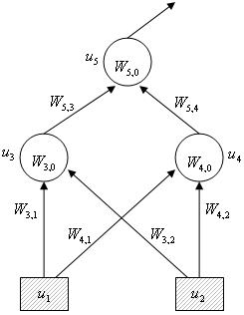
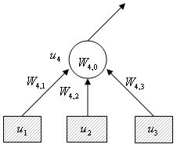
Artificial Neural Networks
An example of a single-cell model
An example of a multi-layer model
Notes:
Here are two small examples of single and multi-layer models of networks. We have to compute the weights of each connector. F is the activation function and S(i) is the weighted sum of cell u(i). W(i;j) determines the effect of cell u(j) on cell u(i)

Slide 24

Applications
Financial Data Analysis
Credit Fraud detection
Trend analysis
Analysing profitability
Risk analysis
Stock price forecasting
Marketing activities
Targeted advertising
Customer buying behavior detection
Automated operator (customer service)

Slide 25
Applications (cont.)
Healthcare and Biomedical Research
Adverse Drug Reactions (ADR)
Disease progress analysis
Children’s growth monitoring
DNA-data analysis
Evaluate the effectiveness of medical treatments
Pandemic prediction
Social Networks
Counter terrorism

Slide 26
Why & When Privacy is Needed?
Privacy Acts
Keep individual and sensitive data private
Financial competition
Top-Secret Data
Military
Government
Research

Slide 27
Privacy-Preserving Data Mining
Main Approaches
Randomization and Anonymization
Challenge
Accuracy vs. Privacy
Uses various techniques
Suppression
Aggregation
Anonymization
Randomization
Data perturbation
Secure Computation
Challenge
Efficiency vs. Privacy
Uses various cryptography and security tools (building blocks)
Chance of data leakage is higher in the first approach

Slide 28

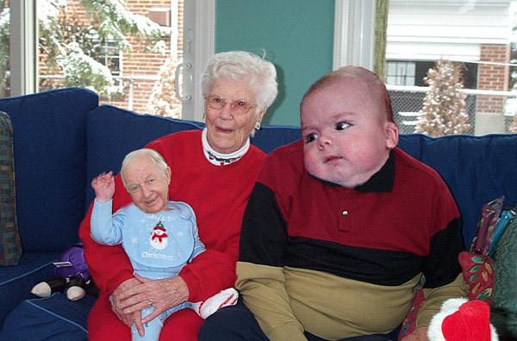
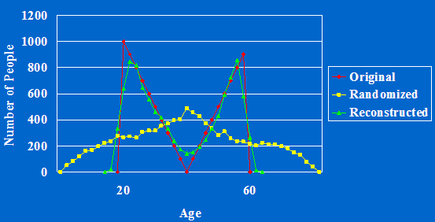
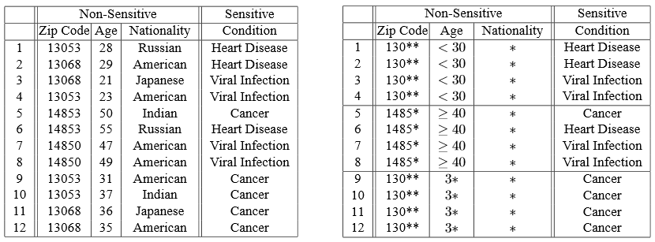
Privacy-Preserving Approaches Anonymization
Notes:
There are two main approaches that are used to preserve the privacy of data; Anonymization, and Secure Computation.
In the first approach, anonymization, various techniques such as randomization and perturbation, aggregation and generalization, sampling, and suppression will be utilized for this purpose.
For instance, k-anonymity is a popular anonymization method, in which the information for each person contained in the release cannot be distinguished from at least k-1 individuals whose information also appear in the release.

Slide 29
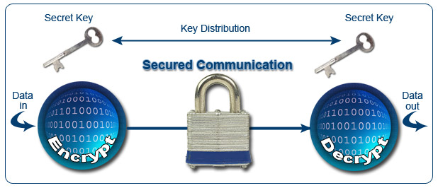
Privacy-Preserving Approaches Secure Computation
Secure Multi-party Factorial
Secure Multi-party Addition
Secure Exponentiation
Notes:
In the second approach, i.e. secure computation, mathematical and cryptography techniques are usually used on data to encrypt data before storing or releasing to data users.
The main idea in secure multi-party computation is that we should have some black-box for secure computation of a given function, using private inputs provided by two or more participants and output private shares to them, or a third party data user

Slide 30
Privacy, Accuracy & Efficiency Trade-off
Anonymization
Privacy vs. Accuracy (Utility)
Secure Multiparty Computation (SMC)
Privacy vs. Efficiency (Performance)
Privacy
Accuracy
Privacy
Efficiency
Notes:
If we want to briefly compare these two approached, in terms of privacy, efficiency (or performance) and accuracy (or data utility), we can say that the main trade-off in the anonymization approach is between privacy and accuracy, which means by increasing privacy, we lose some accuracy of the final result and knowledge from the raw and original data. For instance, if you suppress only 1 to 3 digits from Canadian postal code, data might have some good level of utility. However, if you increase the number of suppressed digits, the final result will lose a high level of utility.
On the other hand, in the second approach, i.e. secure computation, the main trade-off is between privacy and efficiency. This means by increasing the level of privacy, the overall performance of such system well decrease. For instance, if we use small size of encryption keys, say 256 or 512 bits, we will have an acceptable performance, even with using a low-performance, home computer. However, if we want to secure very high sensitive data, we might need to use large encryption keys, say 2048 bits, and thus the overall performance of the encryption and decryption will highly decreased, even with using high-performance computers.

Slide 31
Secure Multi-party Computation (SMC)
Data is distributed
Each party has a part of the whole data
Data could be partitioned
Horizontally
Vertically
Mixed (both horizontal and vertical)

Slide 32
SMC (cont.)
Involved parties (data owners) want to operate a joint function on their private inputs
Functions could be
Data mining algorithm
Statistical analysis methods
Mathematical functions
Concerns
Privacy
Intermediate and/or final outputs reveal no information of the private inputs
Correctness (accuracy of the final results)
Efficiency

Slide 33
SMC (cont.)
Parameters
Parties behavior
Honest
Semi-honest
Malicious
Number of parties involved
Two-party
Multi-party
Parties network type
Client-server
Peer-to-peer
Third-party
Type of final result release
Parties will receive the complete final output
Parties will receive a portion of the final output

Slide 34
Privacy-Preserving Data Mining (cont.)
Examples
Privacy-preserving Decision Tree
Information Gain
Gini Index
Privacy-preserving k-means Clustering
Secure Dot Product
Secure Comparison
Privacy-preserving Association Rule Mining
Secure Binary Dot Product
Cardinality of Set Intersection (Set Intersection Size)
Commutative Encryption
Privacy-preserving Neural Networks
Secure Dot Product
Privacy-preserving Bayesian Networks
Secure Exponentiation
Secure Factorial

Slide 35
SMC (cont.)
Examples
Mathematical operations
Secure Addition
Secure Multiplication
Secure Factorial
Secure Dot Product (SDP)
Secure Comparison
Secure Polynomial Evaluation (SPE)
Secure Set Intersection
Secure Set Intersection Size
Secure Union
Secure Matrix Operations
Addition
Multiplication
Sum Inverse

Slide 36
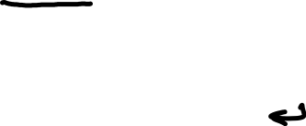
SMC (cont.)
Examples (cont.)
Statistical operations
Secure Mean and Median
Secure Standard Deviation
Secure Logistic Function
Secure 2-norm Distance
Other examples
1-out-of-k Oblivious Transfer (OT)
Private Information Retrieval (PIR)
Secure Sort
Secure Auction
Secure Vote

Slide 37

Example 1 Secure Mean
N₁
N_{n}
There are n participants
Each one has a private number
Mean value of the numbers should be securely computed and released to each person, or a separate user (third party)
None of the participants or any third party will know the private numbers of each other
…
Notes:
Now, at the end, let see two simple examples.
The first one is computing mean of private values in a secure way. Suppose three or more persons, each of whom has a private number, and they want to compute the average of their values, without revealing their private umbers to each other. What would be your solution?

Slide 38



Secure Mean
R=6
5
9
3
7
T←R+5
T ← T+9
T ← T+3
11
20
23
30
T ← T+7
Notes:
One simple solution would be like this:
They consider an order (index) for themselves, say form 1 to n (number of persons)
The first person will select a random number privately, add this number to her private value, and send the result to the second person.
From the second person, to the last person, each one will add her private number to the received value and send it to the next person. Last person will send the result to the first one.
The first person will deduct the random value from the received value, divided by the number of all person and send the final result to the rest of the people.

Slide 39
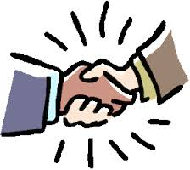
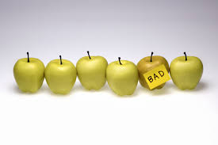
Possible issues
Second and forth persons compromise
They can reveal the third person’s private number
Presence of a malicious person
Incorrect value can be shared by this person
None of the persons, except the malicious one, will receive the correct mean value
Notes:
This simple secure protocol will nicely work. However, if we investigate the protocol steps in more detail, we might find some possible issues.
For instance, suppose the second and forth persons compromise. Then they can easily reveal the third person’s private number.
Another issue is the possible presence of a malicious person among the parties involved in the protocol. A malicious party can send an incorrect value to the next party, and therefore all the parties, except the malicious one who can recover the correct result, will receive an incorrect final result.
So we should improve the protocol by considering these and other possible issues.

Slide 40
A solution for the first issue
Data Segmentation
Each participant breaks her data to k segments
Multi-Round protocol
Protocol will be performed in k rounds
In each round the order of the participants will be rotated
k =1
k =2
k =3
Notes:
A simple solution for the first issue, could be design a collusion-resistant protocol by adding some overhead to the previous protocol, using data segmentation and make a multi-round protocol.
In this solution, each participant breaks her private number to a pre-defined and public number of segments. Then, the previous protocol will be executed for each set of segment. In each round, the order of the participants will be changed to prevent any possible collusion between two parties who are adjacent to one party.

Slide 41
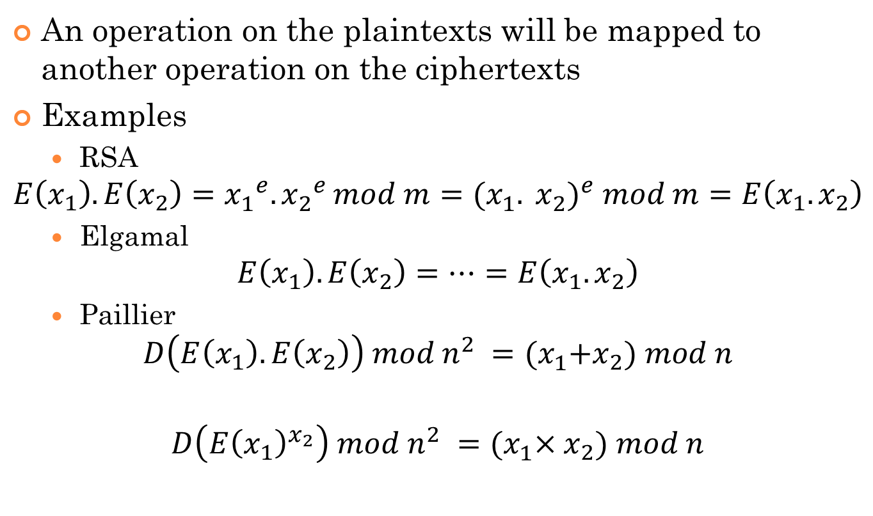
Homomorphic Encryption
An operation on the plaintexts will be mapped to another operation on the ciphertexts
Examples
RSA
Elgamal
Paillier

Slide 42
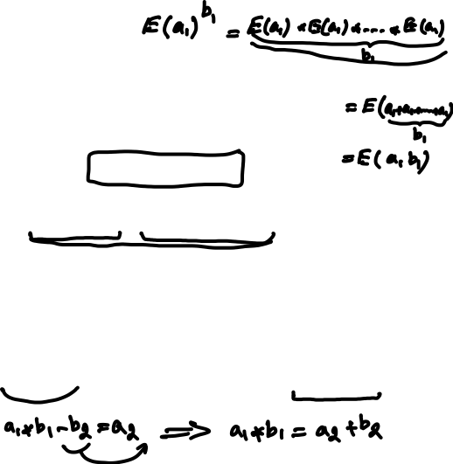
Example 2 Secure Two-Party Multiplication
Additive Homomorphic Encryption (Paillier Cryptosystem)
Steps
What would be an application of this secure building block?
b₂ is random & private
Notes:
The second example is secure two-party multiplication, in which, we can securely convert product of two private shares to the summation of two other private shares.
For this protocol, we will use an additive homomorphic encryption, proposed by Pailler, which is based on RSA public-key encryption. In this cryptosystem, encryption of the addition of two numbers is equal to the production of the encrypted values of those two numbers.
The steps would be as follows:
First, Party A initializes a paillier cryptosystem, encrypts her private input and sends it to Party B

Slide 43
Homomorphic Encryption
Ongoing challenges
Efficient homomorphic cryptosystems
Semi-homomorphic cryptosystems
Unlimited number of one operation
Limited number of one operation
BGN Cryptosystem
Fully homomorphic cryptosystems
Ferrer fully homomorphic encryption
It is not efficient.
It is not secure
Gentry fully homomorphic encryption
Lattice-based cryptography
It supports evaluations of arbitrary depth circuits
It is not efficient and practical yet

Slide 44
Anonymization
k-Anonymity
In a dataset, attributes are suppressed or generalized such that each record is identical with at least k-1 other records
From: l-Diversity: Privacy Beyond k-Anonymity by A. Machanavajjhala et al.
4-Anonymity

Slide 45
Anonymization (cont.)
k-Anonymity (cont.)
Sensitive attribute
An attribute that adversary must not be allowed to discover the value of it for any individual in the dataset
Example
{Condition} in the previous example
Quasi-identifier attributes
A set of attributes that can uniquely identify (or reduce uncertainty about) all or some of the records (by linking with some public, external info)
Example
{zip code, age, nationality} in the previous example

Slide 46
Anonymization (cont.)
k-Anonymity (cont.)
Attacks
Homogeneity attack (Lack of diversity on sensitive attribute)
k-Anonymity can create groups that leak information due to lack of diversity in the sensitive attribute
Example
A neighbor of a patient, using the last equivalence class of the previous example (Condition = Cancer)
Background knowledge attack
Using background external knowledge to reduce the uncertainty and sometimes find a unique record
k-Anonymity does not protect against attacks based on background knowledge
Example
Japanese people have an extremely low incidence of heart disease

Slide 47
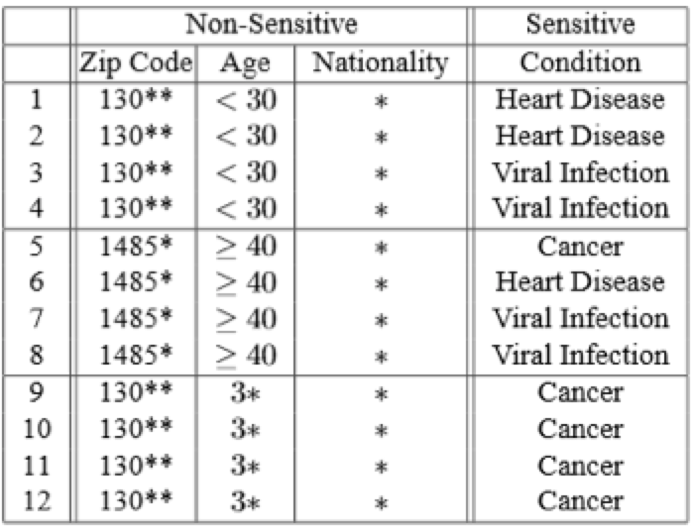
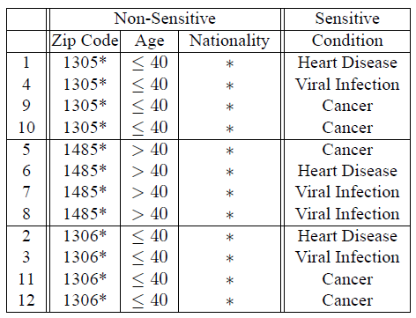
Anonymization (cont.)
l-Diversity
Sensitive attributes must be diverse within each quasi-identifier equivalence class
From: l-Diversity: Privacy Beyond k-Anonymity by A. Machanavajjhala et al.
4-Anonymity , 3-Diverse

Slide 48
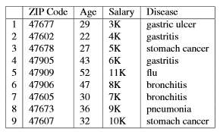
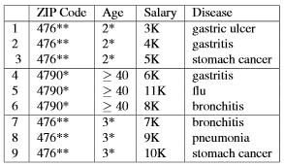
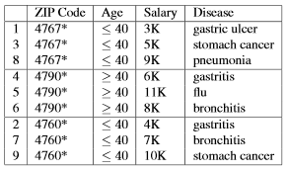
Anonymization (cont.)
t-Closeness
The distribution of a sensitive attribute in any equivalence class is close to the distribution of the attribute in the whole dataset (i.e., the distance between the two distributions should be no more than a threshold t)
From: t-Closeness: Privacy Beyond k-Anonymity and l-Diversity
3-Anonymity, 3-Diverse, t-Closeness
(0.167-Closeness w.r.t Salary, 0.278-Closeness w.r.t Disease)

Slide 49
Attacks on different approaches
Cryptanalysis
Collusion attacks
Two or more parties collude to reach one or more other parties’ private data
Example
Colluding of two parties in Secure Addition protocol
Data de-anonymization and re-identification
Previous examples
Linking with external public datasets
Noise filtering
Inference Attack
Multi-query submission from a dataset
Example
SELECT SUM(salary)‏
SELECT SUM(salary) WHERE lastname != 'Adams'
Using the history of previous query results

Slide 50
Open Issues on Privacy-Preserving Methods
Privacy Risk Analysis
No standard techniques for privacy risk measurement
Privacy-preserving on Social Networks
No single input node
Lack of enough knowledge on privacy by the users
Unstructured data (text-based data)
Privacy-Preserving of Big Data
Efficiency
Communication Complexity
Computation Complexity
Privacy Approaches
A hybrid, and scalable approach including both
SMC
Anonymization
Unstructured data
Common Framework
Efficient Fully Homomorphic Encryption

